Slide 1
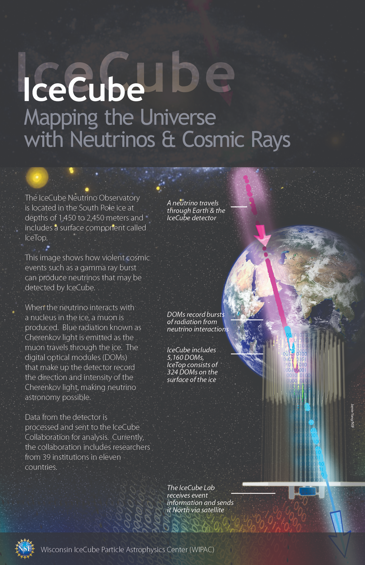
IceCube M&O, the Upgrade, and Gen2
A Facility Perspective
Kael Hanson, Director of Operations
IceCube Neutrino Observatory
Software and Computing Advisory Panel (SCAP) Meeting
27 Jan 2021
Notes:
This set of slides serves to (a) provide the overall picture of what IceCube is and

Slide 2
The Big Picture
How are we doing?
We are beginning a new funding cycle for IceCube Operations. We have asked for a significant increase in funds (+28%) to cover increasing, not diminishing support needs, even to support the baseline Operations. Are we making a good case for this? (We don’t actually know yet our funding level 2 months from now!! More on that later ...).
In addition, we have begun to support facility expansion. Are our resources (labor and hardware) adequate here?

Slide 3
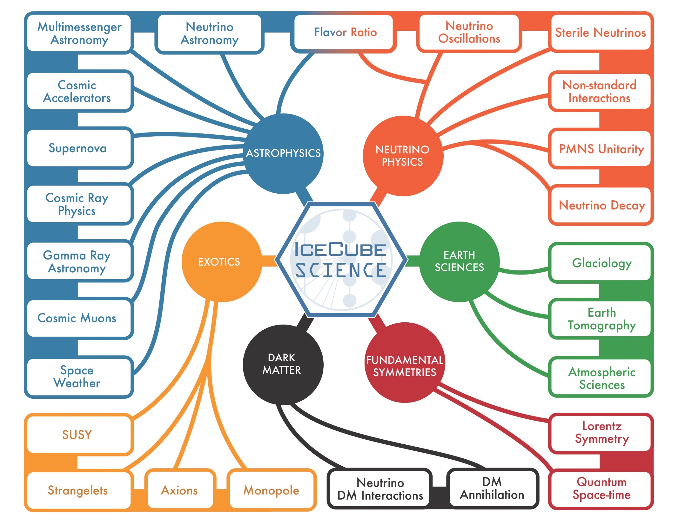
Very broad science program that spans 10 decades in energy (SNe v at MeV to 10 PeV).
Neutrino astrophysics
Beyond SM physics
Neutrino particle properties
Glaciology
RT alerts to MMA community

Slide 4
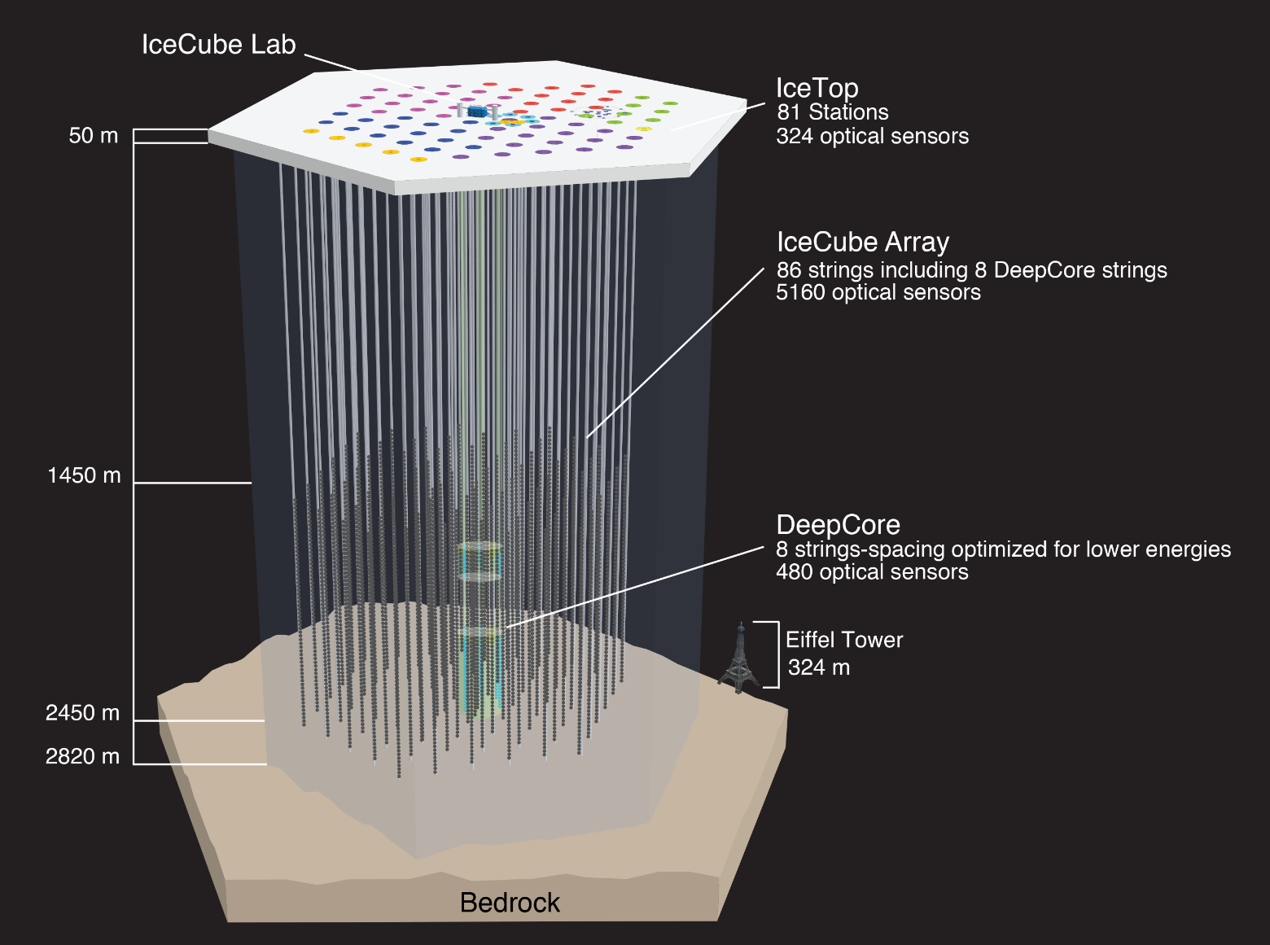
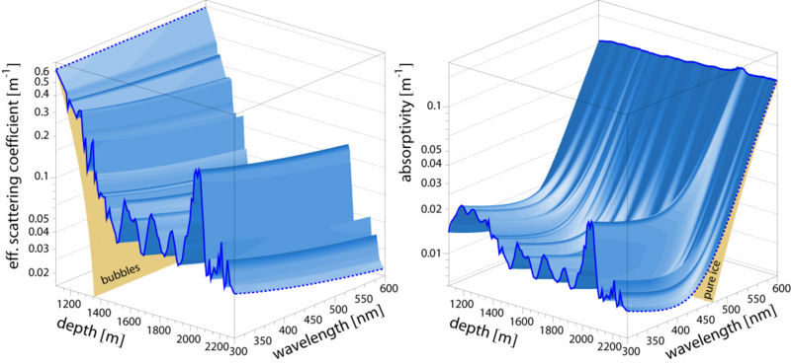
The IceCube Neutrino Detector Array
(at the Geographic South Pole)
Notes:
5160 deep-ice DOMs + 384

Slide 5
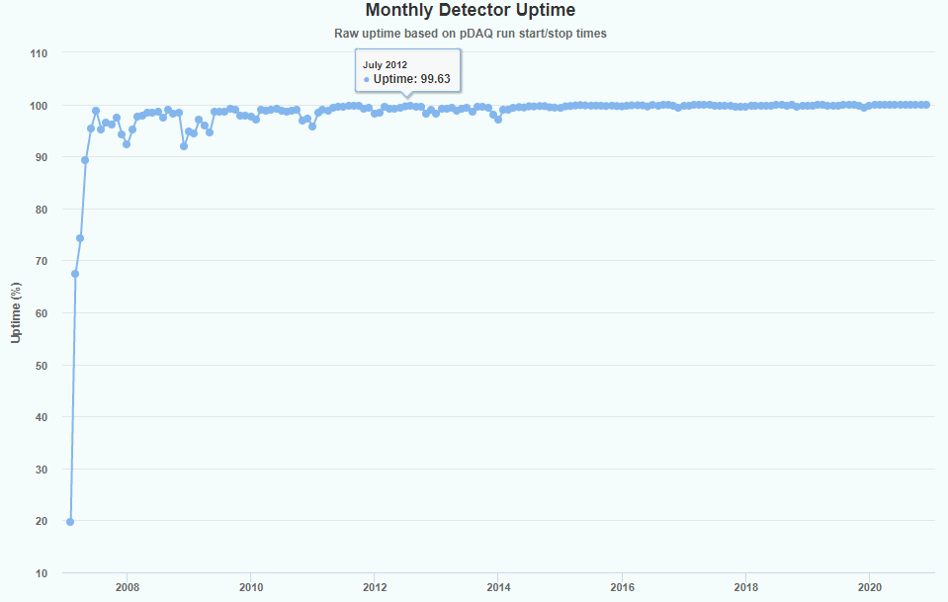
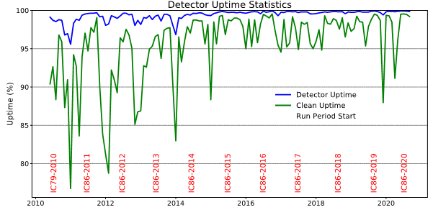
IceCube Data Flow Numbers
~ 3000 Hz of CR events, ~ 3 mHz of atmospheric neutrinos, ~ uHz of astrophysical neutrinos.
1 TB events/day to disk by DAQ.
Satellite sends O(100) GB/day filtered data to NH ready for analysis < 2 weeks. Rest is archived on magnetic disk and sent north each year. Normally this data is not re-processed although we have 2x and are already considering a 3rd.
Detector uptime routinely >> 99%. Dec 2020 uptime was 99.89%

Slide 6
The IceCube Neutrino Observatory
IceCube (Gen-1): $279 million NSF/MREFC 2002-2012 construction of the existing South Pole Array. IceCube is an NSF major facility.
Management and Operations (M&O): sequence of 5 year, mostly, $7 million/year cooperative agreements between NSF and UW/WIPAC to operate detector and provide infrastructure for Collaboration.
IceCube Upgrade: 5 year (planned, 2018-2023) $23.0 million NSF mid-scale to enhance IceCube neutrino physics and ice calibration.
IceCube Gen2: concept-stage future (2026+) facility enhancement – 10x bigger IceCube for neutrino astrophysics.
IceCube Collaboration: scientific collaboration of 350+ researchers world-wide that provide resources (cash, computing, labor) to M&O and receive computing and storage, processed data, simulated data.

Slide 7
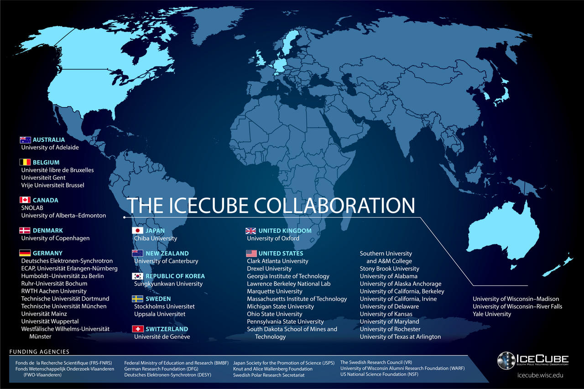
The IceCube Collaboration includes > 350 researchers from 47 institutes in 12 countries.
IceCube is one of the NSF’s large facilities (LIGO, LSST, … 2 dozen others).
The Operations and Management of the facility is handled by WIPAC at UW-Madison. In addition to having a large science group, our center supports the technical aspects: computing, data storage, detector maintenance, …

Slide 8
IceCube Management and Operations
Focus on the Operations aspect of IceCube

Slide 9
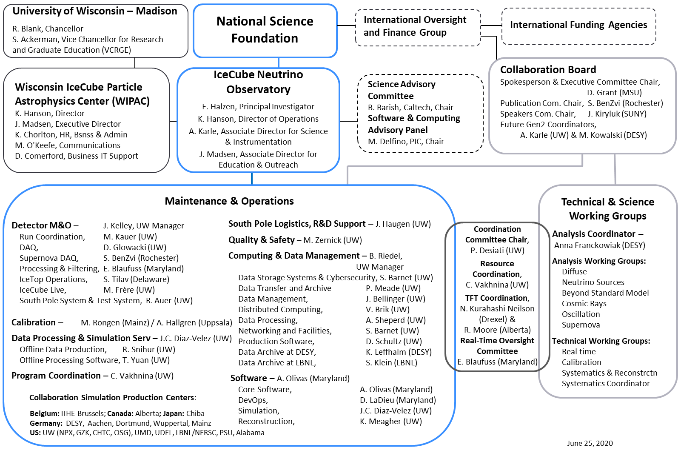
L. Bauerdick, FNAL, Chair

Slide 10
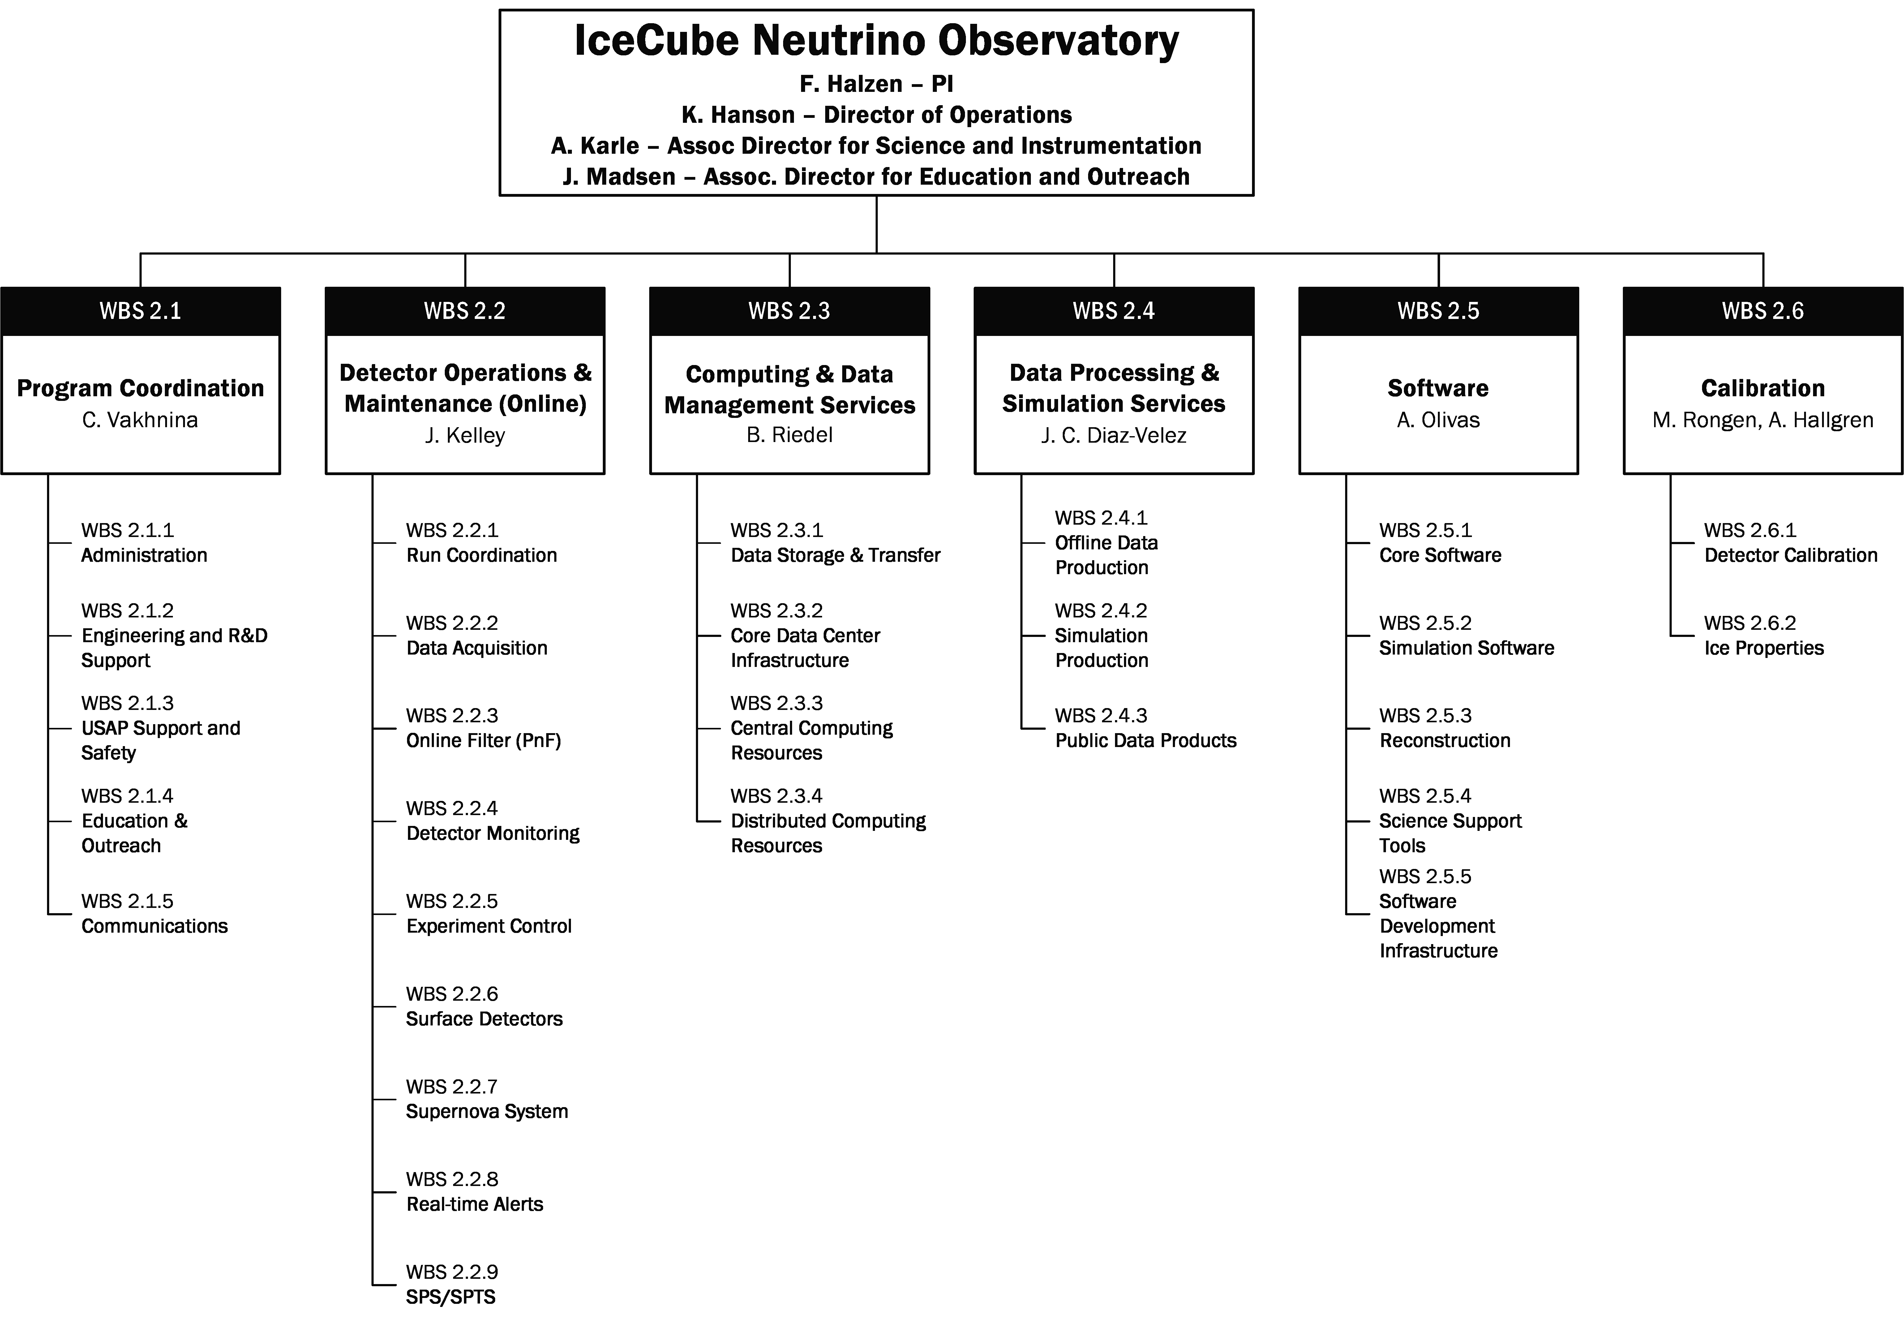
Work Breakdown Structure

Slide 11
M&O Staffing by WBS / Source of Funds (2020)
WBS L2 | NSF M&O Core | NSF Base Grants | U.S. Institutional In-Kind | Europe & Asia Pacific In-Kind | Grand Total
2.1 Program Management | 6.43 | 0.74 | 5.28 | 6.90 | 19.35
2.2 Detector Operations & Maintenance | 14.31 | 2.38 | 3.96 | 8.86 | 29.51
2.3 Computing And Data Management Services | 8.75 | 0.10 | 1.43 | 2.15 | 12.43
2.4 Data Processing & Simulation Services | 2.95 | 0.80 | 1.40 | 5.20 | 10.35
2.5 Software | 3.50 | 1.75 | 6.88 | 8.15 | 20.28
2.6 Calibration | 2.05 | 0.85 | 2.50 | 2.70 | 8.10
Grand Total | 37.99 | 6.62 | 21.45 | 33.96 | 100.02
M&O Centralized Core Responsibility
Collaboration (de-centralized)
Responsibility

Slide 12
M&O Labor by Category (2020)
MoU v.28 - 2020 | U.S. Head Count | U.S. FTE | Non-U.S. Head Count | Non-U.S. FTE
Key Personnel | 45 | 11.35 | 43 | 9.65
Scientists | 30 | 7.78 | 29 | 1.15
Post Docs |  | 5.48 |  | 5.22
Grad Students * | 56 | 12.17 | 74 | 16.44
Data Science, Software, IT, Winterovers, Other ** | 36 | 29.28 | 2 | 1.50
* Grad students' full time employment equals to 0.50 FTE
** Other professionals include engineers, program management (E&O, safety, administration, etc.)

Slide 13
M&O Support Needs
Will be further described later: M&O has been flat at $7.0 (actually decreasd: roll-off of MREFC pre-ops) since 2011.
Thought being that operations becomes easier as observatory matures; this covers things like escalation.
Review / comment our case that operations is not easier
  Support expanding IceCube science program (neutrino physics, evolving use of ML/AI tools).
  Software maintenance timeline >> grad-student lifetime
  Supporting GPUs requires specialized knowledge, i.e. professional
  Integration of IceCube Upgrade falls largely on M&O (DAQ/Online)
  Provide adequate infrastructure to exploit calibration revolution with new devices deployed in Upgrade to bolster IceCube MMA mission.

Slide 14
IceCube Operations 2021 - 2026
New Positions Supported by M&O Core
Next Cooperative Agreement with NSF begins April 1st, 2021.
M&O passed mid-term review with recommendation to not re-compete the operations → WIPAC remains host institution. Sub-award institutions are the same.
Overall increase in labor, but actual decrease in PY1 to meet funding constraint.
Workflow programmer : develop middleware to allow IceCube software to exploit more platforms
Simulation programmer: maintain existing physics and detector simulation codes (i.e. PMT digitization) and implement/support new Upgrade features. This also helps address simulation software efficiency - a noted bottleneck.
Visualization programmer: something as central as the IceCube event viewer has been without identified maintainer. We ask support for maintaining this tool as well as other visualization tools (i.e. web visualization)
Reconstruction support: support / implementation of new reconstruction tools, especially ML based. Again maintain current with eye on software efficiency.
GPU programmer: dedicated support for the photon tracking is needed in particular the specialized nature of skills here demand a dedicated professional to maintain.
FTE Table - M&O Core Only
WBS Element | PY1 | PY2 | PY3 | PY4 | PY5
2.1 Program Coordination | 7.3 | 7.3 | 7.3 | 7.3 | 7.3
2.2 Detector Ops. & Maint. | 11.1 | 11.1 | 11.4 | 11.7 | 11.4
2.3 Computing & Data Management | 8.1 | 8.5 | 9.3 | 9.3 | 9.3
2.4 Data Processing and Simulation Services | 2.4 | 2.4 | 2.4 | 2.4 | 2.4
2.5 Software | 4.7 | 7.7 | 7.7 | 7.7 | 7.7
2.6 Calibration | 2.4 | 2.4 | 2.4 | 2.4 | 2.4
GRAND TOTAL | 36.0 | 39.4 | 40.4 | 40.7 | 40.4

Slide 15
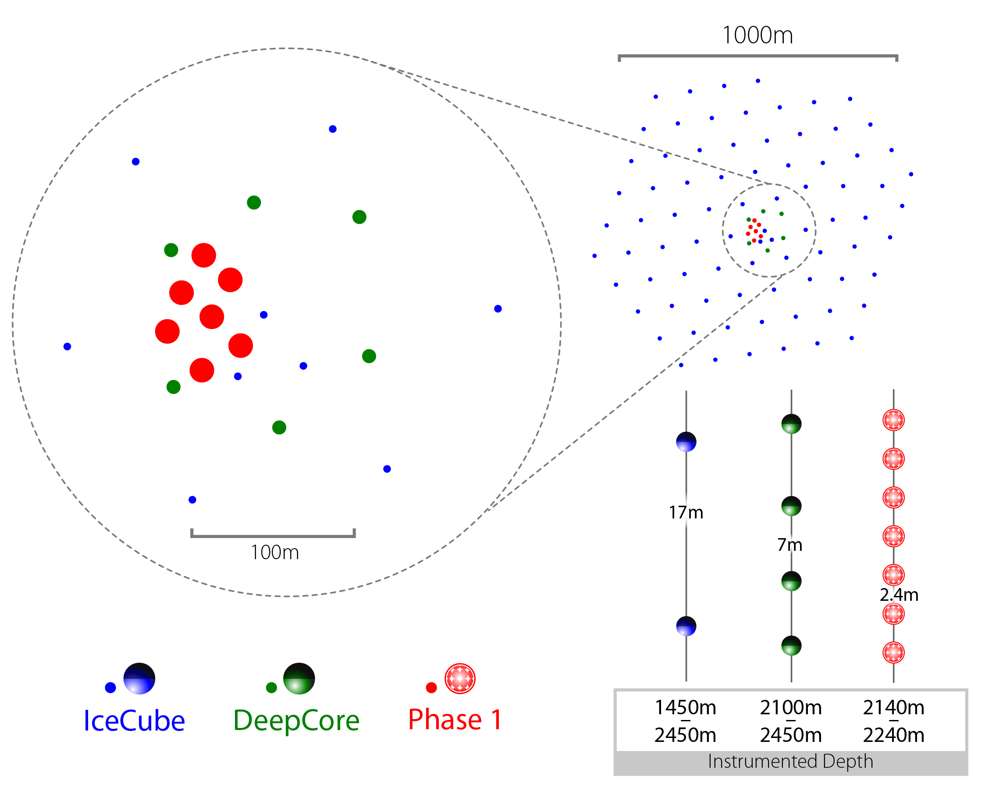
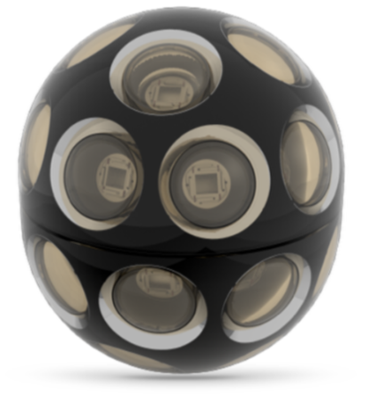
Gen2 Phase 1: First Steps
Science goals:
Probe unitarity of PMNS matrix
Improve calibration and characterization of ice for improved HE multimessenger neutrino astronomy
7 strings densely populated (2x number of modules/string) with next generation, high performance photodetectors:
Integrates with existing IceCube: data acquisition, event filtering, simulation will require extension;
Negligible increase in data rate + storage of experimental data; need essentially parallel simulations so bigger impact there.
No significant increase in steady-state operations: we don’t need more WOs, for example, but now there are 3 types of optical sensors to maintain (F/W and S/W – H/W locked!!)
Timeline (was) 2018 – 2023; all deployment in 22/23 season.
Array | String Spacing | Module Spacing | Modules per String
IceCube | 125 m | 17 m | 60
DeepCore | 75 m | 7 m | 60
Phase 1 | 20 m | 2 m | 125

Slide 16
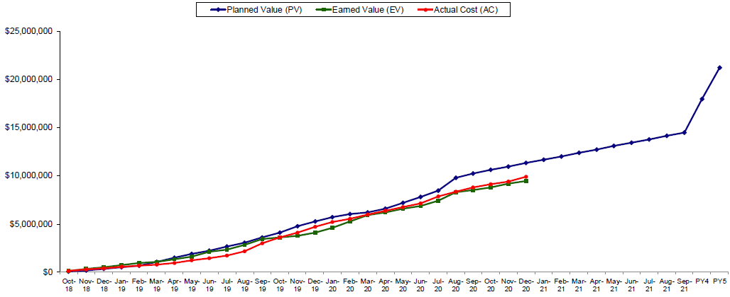
IceCube Upgrade Rebaseline
Technical / financial performance (EVM at least) good up to March 2020. For last year, the project has experienced notable slowdowns.
Biggest impact has been complete cancellation of our 2020/2021 field season.
To lesser degree, impacted by physical access constraints mostly for drill engineering and optical module production.
Estimate cost impact of COVID to be $1.5M.
Project is actively developing a rebaseline plan IAW guidelines established for major facilities construction projects: we are no longer able to execute within the project management baseline: cancellation of field season(s) and delays in logistics mandate at least one additional year and supplemental funding.
We are working with our Project Advisory Panel and NSF on these plans; may trigger an NSB review.
This does alleviate some strain on M&O support – operations support delayed from 2023 to 2024. Overall, this is not a good thing.

Slide 17
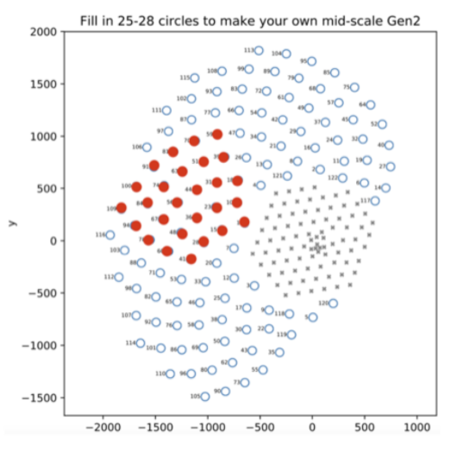
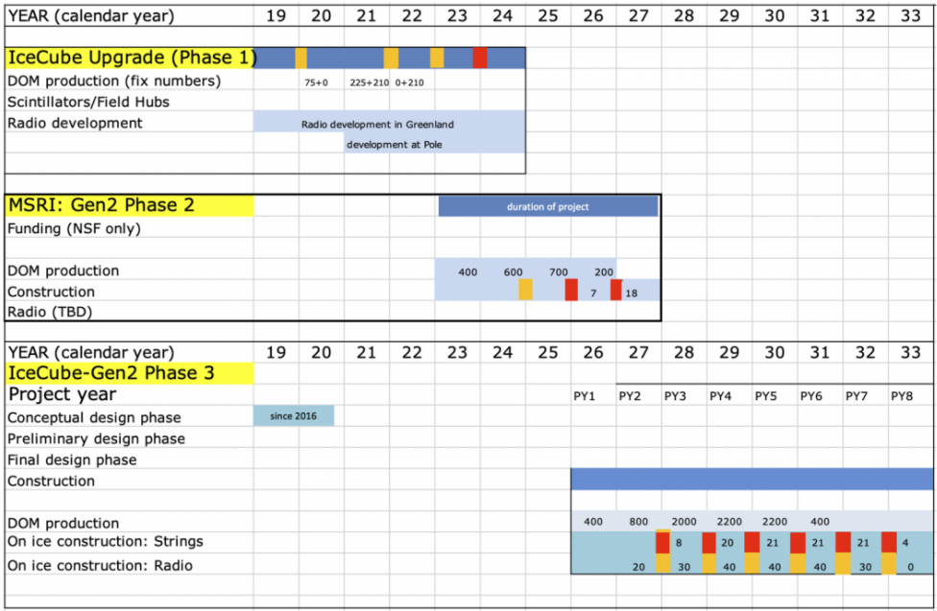
IceCube Gen2 (10x IceCube)
IceCube Gen2 – Phase 1 is the Upgrade - $23.0M mid-scale instrumentation ($37M TPC)
IceCube Gen2 – Phase 2 is MSRI-2 - $100M NSF + $30M (??) non-NSF. We are submitting LoI next week.
IceCube Gen2 – Phase 3 is MREFC $400M TPC. Need to find development funds (> 10%) == difficult. MSRI-2 is potential path.
Orange is pole population; red is deep ice drilling

Slide 18
COVID-19 Impact on IceCube Operations
IceCube Operations is considered Tier-2 in USAP. This meant that we were essential behind human safety and basic station operations and were able to rotate our WO crew 20/21.
We say there has been minimal impact on IceCube Ops due to COVID-19 pandemic. Formal mechanism (EVM) exists for Upgrade project to aid in evaluating $ impact. It’s extremely difficult to pin this down for LoE operations.
We track direct costs associated with COVID-19: $80,949.36.
We evaluate delays against annual plan:
  South Pole OS upgrade and CM system upgrade deferred to 2022+
  Surface array installation (didn’t talk about this) deferred to 2022+
  Rack space consolidation / other minor preps for Upgrade
Furloughs across US institution cut labor by O(5%). There is certainly another multiplicative factor < 1.0 due to remote work.

